Slide 1
React Lifecycle

Slide 2
React Component Life-Cycle
Every component creation process involves various lifecycle methods
These lifecycle methods are termed as component's lifecycle.
Lifecycle of the component is divided into four phases.
Initial Phase
Mounting Phase
Updating Phase
Unmounting Phase

Slide 3
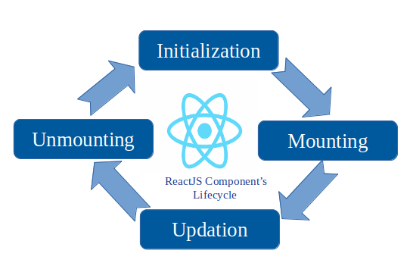

Slide 4
1. Initial Phase
Here component starts its journey on a way to the DOM.
In this phase, a component contains the default Props and initial State.
default properties are done in the constructor of a component.
initial phase only occurs once and consists of the following methods.
getDefaultProps()
It is used to specify the default value of this.props.
getInitialState()
It is used to specify the default value of this.state.

Slide 5
2. Mounting Phase
Mounting means putting elements into the DOM.
React has four built-in methods that gets called, in this order, when mounting a component:
constructor()
getDerivedStateFromProps()
render()
componentDidMount()

Slide 6
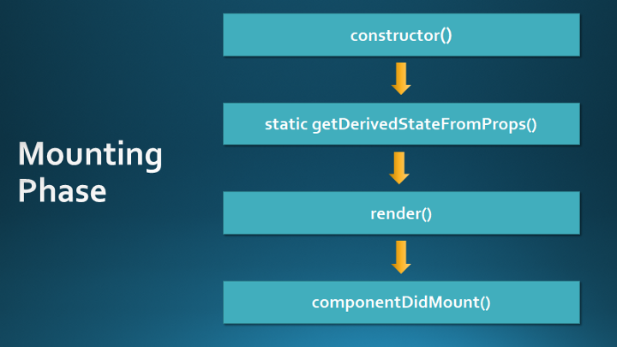

Slide 7
constructor
Before the start of the mounting phase, we may need to initialize our component using a constructor() method.
Used to set initial state and properties of the component.

Slide 8
static getDerivedStateFromProps()
Allows a component to update its states based on changes to its props.
Rarely used and should be used with caution as it can cause errors.
The general rule as a beginner, we probably don’t need it and should avoid using it.

Slide 9
The example below starts with the favorite color being "red", but the getDerivedStateFromProps() method updates the favorite color based on the favcol attribute:

Slide 10
import React from 'react';
import ReactDOM from 'react-dom/client';
class Header extends React.Component {
constructor(props) {
super(props);
this.state = {favoritecolor: "red"};
}
static getDerivedStateFromProps(props, state) {
return {favoritecolor: props.favcol };
}
render() {
return (
<h1>My Favorite Color is {this.state.favoritecolor}</h1>
);
} }
const root = ReactDOM.createRoot(document.getElementById('root'));
root.render(<Header favcol="yellow"/>);

Slide 11
render
render() is the method that actually outputs the HTML to the DOM.

Slide 12
Example
class Header extends React.Component {
render() {
return (
<h1>This is the content of the Header component</h1>
);
} }
const root = ReactDOM.createRoot(document.getElementById('root'));
root.render(<Header/>);

Slide 13
componentDidMount()
Will be immediately invoked after the render function is executed.
If we need to interact with the browser directly, this is where we do it.

Slide 14
Example
export default class Header extends React.Component {
constructor(props) {
super(props);
this.state = {favoritecolor: "red"};
}
componentDidMount() {
setTimeout(() => {
this.setState({favoritecolor: "yellow"})
}, 3000)
}
render() {
return (
<h1>My Favorite Color is {this.state.favoritecolor}</h1> );
}
}

Slide 15
3. Updating Phase
A component is updated whenever there is a change in the component's state or props.
These changes can occur within the component or through the backend.
React has five built-in methods that gets called, in this order, when a component is updated:
getDerivedStateFromProps()
shouldComponentUpdate()
render()
getSnapshotBeforeUpdate()
componentDidUpdate()

Slide 16
getDerivedStateFromProps
This method is the same method used in the mounting phase.
signature of the API is as follows:
static getDerivedStateFromProps(props, state)
props − current properties of the component
state − Current state of the component

Slide 17
export default class Header extends React.Component {
constructor(props) {
super(props);
this.state = {favoritecolor: "red"};
}
static getDerivedStateFromProps(props, state) {
return {favoritecolor: props.favcol };
}
changeColor = () => {
this.setState({favoritecolor: "blue"});
}
render() {
return (
<div>
<h1>My Favorite Color is {this.state.favoritecolor}</h1>
<button type="button" onClick={this.changeColor}>Change color</button>
</div>
);
} }
ReactDOM.render(<Header favcol="yellow"/>, document.getElementById('root'));

Slide 18

Output
If I click on change color button the color will not change because getDerivedStateFromProps is called after render soo

Slide 19
shouldComponentUpdate
It is invoked when a component decides any changes/updation to the DOM.
It allows to control the component's behavior of updating itself.
If this method returns true, the component will update.
Otherwise, the component will skip the updating.

Slide 20
Example
class Header extends React.Component {
constructor(props) {
super(props);
this.state = {favoritecolor: "red"};
}
shouldComponentUpdate() { return true; //return false }
changeColor = () => { this.setState({favoritecolor: "blue"}); }
render() {
return (
<div>
<h1>My Favorite Color is {this.state.favoritecolor}</h1>
<button type="button" onClick={this.changeColor}>Change color</button>
</div>
); } }

Slide 21


Output when true color will be updated

Slide 22
getSnapshotBeforeUpdate
We have access to the props and state before the update, meaning that even after the update, we can check what the values were before the update.
If the getSnapshotBeforeUpdate() method is present, we should also include the componentDidUpdate() method, otherwise we will get an error.

Slide 23
export default class Header extends React.Component {
constructor(props) {
super(props);
this.state = {favoritecolor: "red"};
}
componentDidMount() {
setTimeout(() => {
this.setState({favoritecolor: "yellow"})
}, 1000)
}
getSnapshotBeforeUpdate(prevProps, prevState) {
document.getElementById("div1").innerHTML =
"Before the update, the favorite was " + prevState.favoritecolor;
}
componentDidUpdate() {
document.getElementById("div2").innerHTML =
"The updated favorite is " + this.state.favoritecolor;
}
render() {
return (
<div>
<h1>My Favorite Color is {this.state.favoritecolor}</h1>
<div id="div1"></div>
<div id="div2"></div>
</div>
);
}
}

Slide 24

Output

Slide 25
componentDidUpdate
Is called after the component is updated in the DOM.

Slide 26
export default class Header extends React.Component {
constructor(props) {
super(props);
this.state = {favoritecolor: "red"};
}
componentDidMount() {
setTimeout(() => { this.setState({favoritecolor: "yellow"}) }, 1000)
}
componentDidUpdate() {
document.getElementById("mydiv").innerHTML =
"The updated favorite is " + this.state.favoritecolor;
}
render() {
return (
<div>
<h1>My Favorite Color is {this.state.favoritecolor}</h1>
<div id="mydiv"></div>
</div>
); }
}

Slide 27
4. Unmounting Phase
It is the final phase of the react component lifecycle.
It is called when a component instance is destroyed and unmounted from the DOM.
This phase contains only one method and is given below.
componentWillUnmount()

Slide 28
componentWillUnmount()
This method is invoked immediately before a component is destroyed and unmounted permanently.
It performs any necessary cleanup related task such as invalidating timers, event listener, canceling network requests, or cleaning up DOM elements.
If a component instance is unmounted, we cannot mount it again.

Slide 29
Example 1
class App1 extends React.Component {
constructor() {
super();
this.state = {
delete: false,
};
}
render() {
return (
<div>
<h1>User List</h1>
<button onClick={() => this.setState({ delete: true })}>
Delete Users
</button>
{this.state.delete ? null : <User />}
</div>
); } }

Slide 30
Contd…
class User extends React.Component {
componentWillUnmount() {
alert('Deleted User successfully');
}
render() {
return (
<div>
<h3>Username: Akash</h3>
<h3>Email: Akash@gmail.com</h3>
</div>
);
}
}
export default App1;

